Slide 1

M
Octrol M
Enterprise AI Governance
Deterministic control for autonomous agents — bounded, audited, and provable before every call.
ed@octrol.com octrol.com Customer briefing · July 2026

Slide 2





THE PROBLEM
AI agents are live. Nobody is in control.
No hard limits
No audit trail
An agent can loop, blow up its context, or run away with cost. Step and time caps only stop it after the fact.
No record of what ran, what it called, who approved it, or what it cost.
No proof for regulators
Hallucinated outputs
EU AI Act, FCA and SEC require documented evidence of AI governance. Most firms have none.
LLMs fabricate citations and data. Elimination is the goal, so every output is verified to catch what slips through.
Octrol M · Enterprise AI Governance · Confidential

Slide 3



WHY OCTROL M · ORIGIN
Why we built this.
An agent is a control system
It won't fall out of the sky
Math code, not math
Control-engineering tools — saturation limits, runaway detection — applied to agents: the same feedback loop, the same failure mode.
An agent won't fall out of the sky. But ungoverned, it runs away with tokens, cost, and time without bound.
Generated math code checked out — validated against a symbolic engine before it ran. That's evidence about code generation, not direct arithmetic.
A CONTROL-ENGINEERING INSIGHT
THE SAME METAPHOR OF INSTABILITY
ROUTE THE STOCHASTIC TO THE DETERMINISTIC
Not a governance dashboard bolted onto an agent — control theory applied directly to how agents actually fail.
Octrol M · Enterprise AI Governance · Confidential

Slide 4





WHY OCTROL M · MECHANISM
Every call passes through M — before it happens.
1
2
3
4
5
Agent request
Check bounds
Approve / block
Sign & chain
Audit
Agent initiates a call
Twin projects the call forward; exact bounds are checked at dispatch
Within bounds: proceed. Breach: blocked instantly
SHA-256 signed and hash-chained
Append-only. Tamper-evident. Verifiable
Contains no AI whatsoever. No stochastic model anywhere in the enforcement path — the twin is a deterministic simulation and can block a call before dispatch; it cannot be prompted, deceived, or bypassed by the agents it governs.
Octrol M · Enterprise AI Governance · Confidential

Slide 5


WHY OCTROL M · THE PRINCIPLE
OCTROL M
Don’t use a model to govern a model.
A stochastic instrument can’t govern a stochastic system. Octrol M puts no AI in the control path at all.
THE COMMON APPROACH
OCTROL M
Monitor agents with agents
Model the agent and its tools
An LLM watching an LLM
The instrument is as unpredictable as what it measures
It can't reliably predict its own behavior — so it can't govern anyone else's
No model in the control path — nothing to inject or mis-predict
Tools are profiled, so every call is metered exactly before it runs
The guarantee is arithmetic, not a guess
Generated math and code route to real solvers — verified before they run, not trusted after
Both are deterministic, and both can block a call. The twin projects the call forward and can stop it before dispatch; the hard check independently measures it at dispatch. Two arithmetic checks, not one guess and one guarantee.
Octrol M · Enterprise AI Governance · Confidential

Slide 6



WHY OCTROL M · HOW IT WORKS
A governed agent runtime, end to end.
An LLM orchestrator executes multi-step tasks with a fleet of deterministic tools, inside a governance envelope that bounds, observes, forecasts and audits every run.
PROMPT SOURCE
M-CONTROL · GOVERNANCE ENVELOPE
TOOL INTAKE DOMAINS
Machine-
generated
Governor
Data & Query
Documents
Solvers & Verification
Capital Markets
External APIs
Code & Systems
Regulatory & Compliance
Orchestrator
Digital Twin
Profiler & Audit
Human-
generated
Observability Surface
RAG Database
Tools
MCPP-RPC
MCP Servers — tool gateway
API / HTTP
LLMs — your choice
Prompt in, governed tool calls out — every request metered, permitted or blocked, then signed into an audit chain.
Octrol M — M-Control reference architecture · Confidential

Slide 7




WHY OCTROL M · THE GUARANTEE
Four hard bounds, checked before every call.
Steps
Tokens
Cost
Time
Guards logic loops and runaway delegation.
Guards context-window blowups — bounded to one call's overshoot, zero with the twin.
A hard dollar ceiling per run — bounded overshoot, zero when the twin predicts ahead.
Guards hung tool calls and latency-sensitive contexts.
Competitors cap steps and time after the fact. Only M enforces a hard token and cost ceiling before the call is made.
Octrol M · Enterprise AI Governance · Confidential

Slide 8



WHY OCTROL M · THE ANSWER
Bound. Gate. Record.
Three mechanisms, on every step of every run.
Bound
Gate
Record
Before the call. Steps, tokens, cost and time each have a ceiling — a step that would breach does not happen.
On what comes back. Sources real? Answer supported? No source means no answer — the failure mode is silence, not invention.
What it holds. Every step, and the value the system acted on — hash-chained, sub-agents included.
None of the three asks the model to co-operate. This bounds resources, not side effects — write tools need an approval step on the action, on the roadmap, not in the product.
Octrol M · Enterprise AI Governance · Confidential

Slide 9
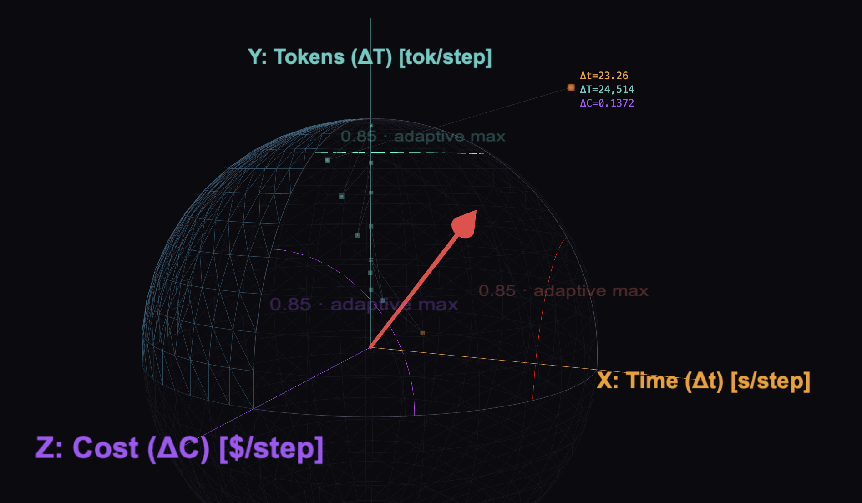
WHY OCTROL M · WHAT "BOUNDED" MEANS
A run is a path. The limit is a surface.
Not three numbers in a configuration file — one boundary the run may not cross, on all three axes at once.
A path, not a number
A cost figure tells you where a run is. The trail tells you where it’s heading, and how fast it got there.
The surface is the policy
Move the sphere and you’ve changed the governance. No code, no redeployment.
The corner is the danger
A run can sit inside every single axis and still be near the surface — three limits checked separately would miss it.
Drawn at 85% of the maximum
So you watch a run approach the boundary, rather than discovering it crossed one.
Octrol M · Enterprise AI Governance · Confidential

Slide 10
WHY OCTROL M · ADOPTION
Any LLM. One endpoint. One afternoon.
YOU BRING
M CONTROL WIRES THE REST
YOU GET
Any LLM
M Control
Governed agent
GPT · Claude · Llama · Bedrock
Connects tools · injects memory · enforces policy · starts audit chain
Live · audited · cost-bounded
EXAMPLE USE CASE
Governed · Audited · Cost-bounded
Risk Morning Report Agent
LLM
Your choice
TOOLS
Bloomberg · Risk DB · Email
MEMORY
Prior reports + thresholds
OUTPUT
Daily Risk Committee brief
Octrol M · Enterprise AI Governance · Confidential

Slide 11

WHY OCTROL M · IN THE PRODUCT
See it run: live bounds, enforced.
M
M Controller
ACME • Regulated Environment
COMPLIANCE ACTIVE
AUDIT TRAIL ON
STEP 03 — EXECUTION & RESULTS
RT Results vs. Bounds
✓ ALL ENFORCED
TIME
243s / 300s
ENTROPY
0.87
COST
$9.80 / $12.50
Cryptographic tracing Verified
TOKENS
87k / 120k
MODEL / COST COMPARISON
ITERATIONS
11 / 15
Claude 3.7 · lowest cost
The actual M Controller run screen — every bound measured against your limits, live, and signed into the audit chain.
Octrol M — M Controller · Execution & Results · Confidential

Slide 12


WHY NOW · THE URGENCY
Autonomy removes the control that was governing it.
Copilots
Agents that act
Volume
A person reads every output. The control is a human being — reliable, but it doesn’t scale.
The human reads a summary, not the raw output. The control is already thinning.
Thousands of runs a day. Review becomes sampling — and sampling is not governance.
THE CONTROL IS A HUMAN BEING
THE CONTROL IS THINNING
THERE IS NO HUMAN IN THE LOOP
So the control has to move into the system — not because people are unreliable, but because nobody reads the four-thousandth run of the day. The obligations already assume you did: EU AI Act, FCA and SEC expectations are enforced, not advised.
Octrol M · Enterprise AI Governance · Confidential

Slide 13


THE TEAM
Built by people who've done this before.
Ed Simmons
Melvyn White
Co-Founder
linkedin.com/in/simmonsed
Co-Founder
linkedin.com/in/melvyn-white-44450011
Octrol M · Enterprise AI Governance · Confidential

Slide 14
WHY OCTROL M · ROADMAP
What’s live, and what’s next.
LIVE
LIVE
READY
SOON
M Control
M Policy
M Observatory
M Lab
The governance control plane. Deploy into your AWS VPC and start governing agents today.
Rules engine fully operational. Write policy in YAML today.
Connects to Splunk, Datadog and the observability stack you already run.
Safe simulation and experimentation — run what-if scenarios before going live.
Full UI — available now
Visual editor in 2 weeks
Inside your existing stack
Coming soon
Octrol M · Enterprise AI Governance · ed@octrol.com · octrol.com

Slide 15



M
THE ASK
Start with 30 days.
We deploy into your cloud account or in your data center. You govern your agents. You decide.
SHA-256 hash-chained audit — tamper-evident
Deterministic pre-call bound enforcement
On-premises — your data never leaves your VPC
ed@octrol.com octrol.com

